Slide 1



Porto Business School
19/05/2025

Slide 2
PBS
OSINT
THE POWER OF OSINT
Agenda
Before OSINT
Internet of Things
OSINT
Awareness
Page 2

Slide 3





PBS
OSINT
THE POWER OF OSINT
Disclaimer & Legal Considerations
Presentation is solely for educational and awareness purposes.
Live content may be unpredictable and potentially inappropriate for some viewers.
Users must check the legality of OSINT tools and methods in their country.
This presentation is not related to my work or employer.
images: Flaticon.com
Page 3
Notes:
It's crucial to understand the ethical implications and legal boundaries when gathering information from open sources. This context will help the audience appreciate the responsible use of OSINT techniques in uncovering information without infringing on privacy or legal rights.

Slide 4

PBS
OSINT
THE POWER OF OSINT
Disclaimer & Legal Considerations
Portuguese Law
Diário República Eletrónico (link)
ANACOM (link)
Organizations
CNCS – Centro Nacional de Cibersegurança (link)
Incident Notification (link)
CERT.PT (link)
Unidade Nacional de Combate ao Cibercrime e à Criminalidade Tecnológica (UNC3T) (link)
Ministério Público (link)
Page 4

Slide 5

PBS
OSINT
THE POWER OF OSINT
Disclaimer & Legal Considerations
ARTIFICIAL
INTELLIGENCE
Was heavily used for this presentation
Use available technologies but check facts.
Always check facts.
AI is more than ChatGPT. Grok, Claude, …
Use them all.
Page 5
Notes:
It's crucial to understand the ethical implications and legal boundaries when gathering information from open sources. This context will help the audience appreciate the responsible use of OSINT techniques in uncovering information without infringing on privacy or legal rights.

Slide 6
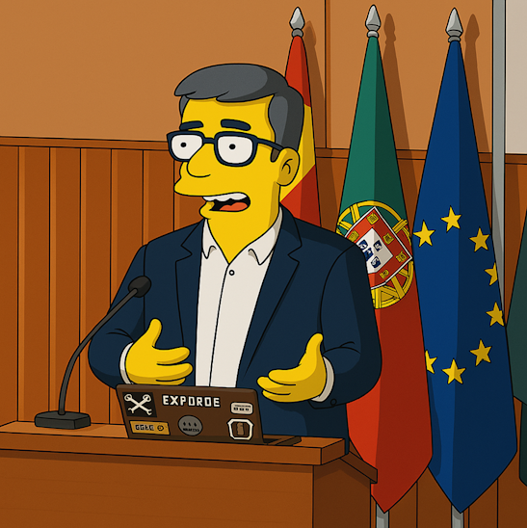
PBS
OSINT
THE POWER OF OSINT
$whoami
👓 Pedro António Oliveira Vieira
🔐 Cybersecurity Engineer
🕵️ OSINT
✒️ Full stack developer
👨‍🏫 Public Speaker
Page 6
Notes:
Pedro Vieira, a cybersecurity engineer and OSINT expert. His diverse background as a full-stack developer and public speaker positions him uniquely to discuss the intersection of technology and intelligence gathering. This slide highlights his credentials, establishing his authority on the subject matter and setting the tone for the insights he will share throughout the presentation.

Slide 7

PBS
OSINT
THE POWER OF OSINT
AWARENESS
Page 7

Slide 8

PBS
OSINT
THE POWER OF OSINT
Awareness - True stories – Quiet vacations
Long last deserving vacations
Too many friends at destination
So, warn no one and just relax on vacations
I posted a picture on social media
My friends were alerted I was nearby
Friends on that location called me on the phone
Everyone else knew I was not home
Burglars love that kind of information
Not public profile. At least I think it is not (rules change)
Someone could have shared the photo with the world
Page 8

Slide 9

PBS
OSINT
THE POWER OF OSINT
Awareness - True stories – Healthy Meal
Someone posted a photo of healthy meal during COVID
Working remotely on in the usual business environment
Company laptop was in the background
Zoomed in and was possible to read emails
Company private information could be leaked
Personal information of other persons was showing
Social Media Networks use OCR
Means they also read the emails
And everyone else on that social media could get the same information
Page 9

Slide 10

PBS
OSINT
THE POWER OF OSINT
Awareness - True stories – Store Credit
Buying a book for almost no money
How I was able to get money just by having the right information
Store clerk asked for store customer card
Gave mobile number and full name
Store clerk asked if I wanted to use balance credit
I accepted and little had to pay
Mobile number and full name were not mine
Page 10

Slide 11

PBS
OSINT
THE POWER OF OSINT
Awareness - True stories - Customer Information (RGPD)
Requesting invoice with NIF (not mine)
Invoice containing:
Name
Address (Shipping address)
Adding store loyalty card with phone number
Invoice containing:
Name
Address (Shipping address)
Updating someone’s client data in store counter
Phone number
Email and address
Page 11

Slide 12

PBS
OSINT
THE POWER OF OSINT
OSINT
Page 12

Slide 13

PBS
OSINT
THE POWER OF OSINT
OSINT - Definition
Open-source intelligence (OSINT) is the collection and analysis of data gathered from open sources (overt and publicly available sources) to produce actionable intelligence. (Wikipedia)
Gathering information from:
government sites
search engines (Google, …)
social media (Facebook, …)
maps
…
And then extract/relate/infer new information with greater value/potential
Page 13

Slide 14

PBS
OSINT
THE POWER OF OSINT
OSINT Time
“Information is not knowledge”
Albert Einstein
Page 14

Slide 15
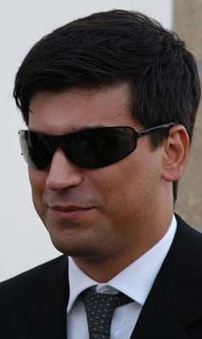
PBS
OSINT
THE POWER OF OSINT
Who am I? – Let’s OSINT me
Starting with just a name
Pedro António Oliveira Vieira
Google it (link)
Google “Improved Search” (link)
Google “Improved Search” + Company (link)
LinkedIn (link)
Anonymous view (Just keep trying)
Public profile was showing way too much
My GitHub notes (link)
Search, and then search again
Page 15

Slide 16
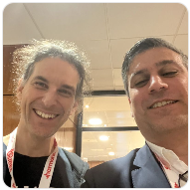

PBS
OSINT
THE POWER OF OSINT
Who am I? – Let’s OSINT me – AI version
What can you tell me about "Pedro Vieira". He is into cybersecurity and OSINT?
Pedro Vieira is a notable Portuguese cybersecurity professional with a strong focus on ethical hacking and open-source intelligence (OSINT).
🛡️ Career Highlights
Top EC-Council Ethical Hacker: In January 2022, Pedro Vieira achieved the highest score globally on the EC-Council’s Certified Ethical Hacker (C|EH) Practical exam, earning the prestigious C|EH Master credential.
Conference Speaker: Pedro was a featured speaker at RootedCON Portugal 2024, one of the country's leading cybersecurity conferences. His talk, titled “OSINT. Beware your data is out there,” explored how publicly available information can be used to uncover sensitive data and highlighted the importance of privacy awareness.
🧰 OSINT Contributions
GitHub Repository: Pedro maintains a comprehensive GitHub repository dedicated to OSINT. This resource includes:
Guides and notes on OSINT techniques
Write-ups from platforms like TraceLabs and Hacktoria
Training materials and curated tool lists
Links to OSINT handbooks and educational videos
💼 Professional Role
Cybersecurity Engineer at Bosch: Pedro has been serving as a cybersecurity engineer at Bosch Group in Braga, Portugal, since January 2020.
Page 16

Slide 17

PBS
OSINT
THE POWER OF OSINT
Who Are You? – Search yourself
Search your name on Google and analyze the results
As you saw the search can be improved
That is typically information to verify your identity over a phone call.
EXERCISE TIME
Page 17

Slide 18

PBS
OSINT
THE POWER OF OSINT
Search Engines - Internet is more than Google
Different search engine different rules/crawlers different results
Google (link)
Bing (link)
DuckDuckGo (link)
Baidu (China) (link)
Yandex (Russia) (link)
SAPO (Portugal) (link)
Page 18
Notes:
You may ask to be removed from one search engine, not all ☹

Slide 19
PBS
OSINT
THE POWER OF OSINT
Improve the search - Search operators
filetype: search your results based on the file extension
cache: allows you to view cached version of the web page.
allinurl: restricts results to pages containing all the query terms specified in the URL.
inurl: restricts the results to pages containing the word specified in the URL
allintitle: restricts results to pages containing all the query terms specified in the title.
link: searches websites or pages that contain links to the specified website or page.
info: finds information for the specified web page.
location: finds information for a specific location.
42 Advanced Operators (link)
Page 19

Slide 20

PBS
OSINT
THE POWER OF OSINT
Improve the search - Google Dorks - Commonly used searches
Google Advanced Search (link)
Google Hacking Database (link)
gbhackers (link)
google-dork-list (link)
Google Advanced Operators Guide (link)
Page 20

Slide 21
PBS
OSINT
THE POWER OF OSINT
Improve the search or “Go lazy” – Go IA
LLMs are like search engines on steroids
LLMS / Chatbots
ChatGPT (link)
Grok (link)
Claude (link)
Models are bound by rules. They often don’t provide personal information
Well, at least some commercial models
EXERCISE TIME
Page 21
Notes:
You may ask to be removed from one search engine, not all ☹

Slide 22

PBS
OSINT
THE POWER OF OSINT
Search in the past - The internet knows and doesn’t forget
Posted information in private mode can be made publicly and world available by someone else
When information is posted
Shows where you are at that time (habits & routines)
The internet has memory
Arquivo.pt (link)
Example (link)
Internet Archive - Wayback Machine (link)
Example (link)
Page 22

Slide 23

PBS
OSINT
THE POWER OF OSINT
OSINT - Profile
Phone number (Years using the same number)
Sync.Me (link)
Username
WhatsMyName (link)
Email (Username reuse)
Gmail (link)
Social Networks (Same username)
Facebook (link)
LinkedIn (link)
Tinder (link) (link)
If you don’t have an account, I can create one and reach your friends.
Page 23

Slide 24

PBS
OSINT
THE POWER OF OSINT
OSINT - Maps
Never been there. Know it like the back of my hand.
Street view
Google Street View (link)
Map/ Satellite
Google Maps (link)
Dual Maps (link)
Overpass Turbo (link)
Wizard: plant:source=nuclear
World Imagery Wayback example (link)
Tips, Tricks and Techniques (link)
Page 24
Notes:
Identify house by address
Assess security (cameras, fences, ...)
Parked cars (timeline, ...)
People’s habits/routines, timetables, ...

Slide 25
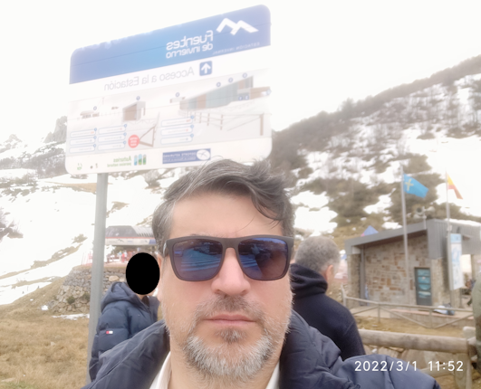
PBS
OSINT
THE POWER OF OSINT
OSINT - Photos
One image is worth 1000 words, maybe more.
What information can be extracted from a photo ?
Photo analysis
Location (link)
Date it was taken
Identifying elements in the photo
Boards
Signs
Flags
The professionals (video explaining) (link)
Page 25

Slide 26
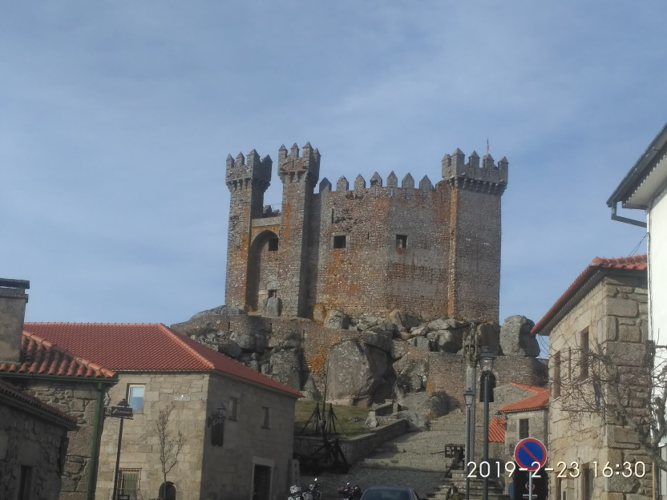
PBS
OSINT
THE POWER OF OSINT
OSINT – Photos - Identify the location
Where was this image taken?
Have you been there?
When?
Date stamp on photo
Filename with date
Metadata
What else?
Image search
Identify the castle? (link)
EXERCISE TIME
Page 26

Slide 27
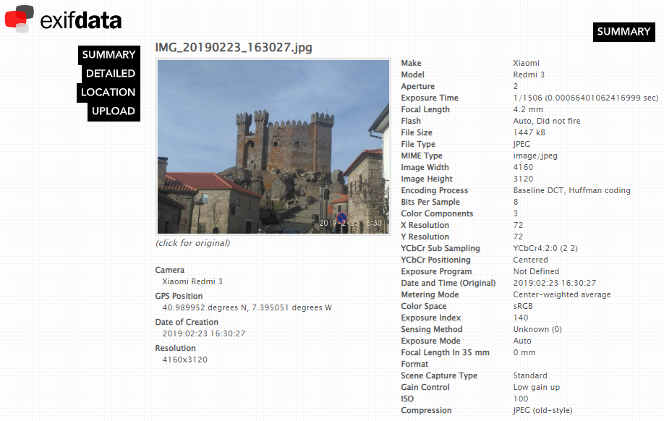
PBS
OSINT
THE POWER OF OSINT
OSINT – Photos - Identify the location
An image is worth a thousand words
File analysis
Metadata
GPS (link)
Google Maps (link)
Tools
CleanUp (link)
AperiSolve (link)
Page 27

Slide 28
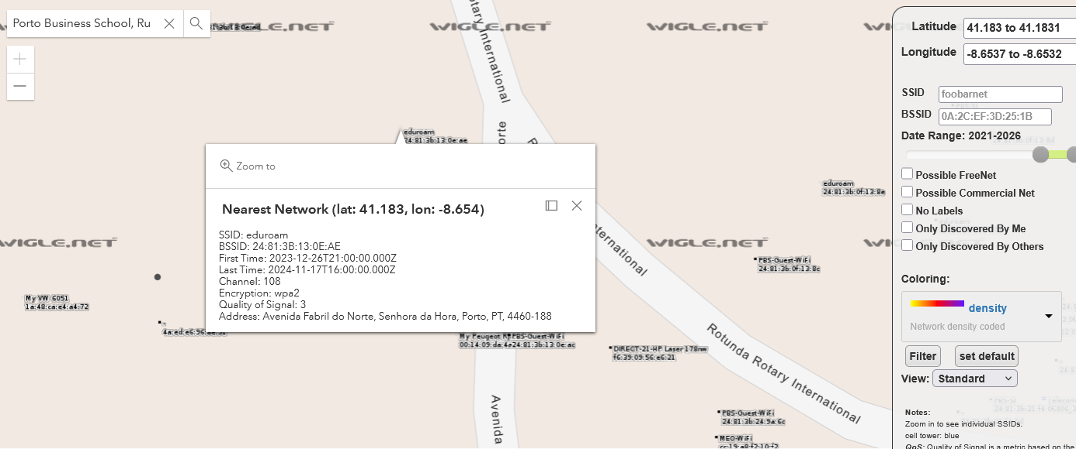
PBS
OSINT
THE POWER OF OSINT
OSINT - World Map - WiFi Networks
Wiggle (link)
Routers
Printers
Cars
IoT
…
Page 28

Slide 29

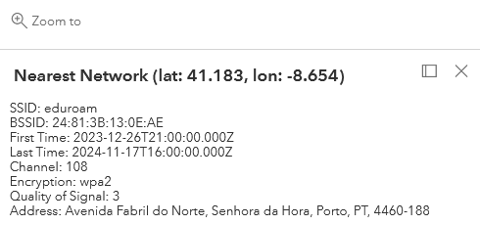
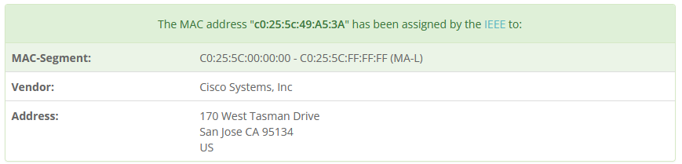
PBS
OSINT
THE POWER OF OSINT
OSINT - World Map - WiFi Networks
Wiggle (link)
Page 29

Slide 30


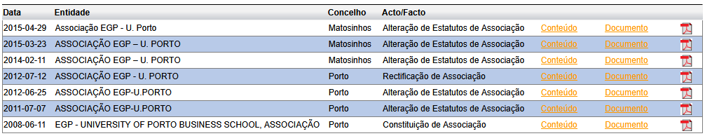
PBS
OSINT
THE POWER OF OSINT
OSINT - Companies
Demo Time
Porto Business School | Porto Business School (link) Google - Search PBS NIF (link) 508541832
Portal | IMT - Instituto da Mobilidade e dos Transportes
 | CAE (link) CAE Principal – 85400 – Ensino Superior 35123 - Produção de eletricidade de origem solar 70200 - Atividades de consultoria ...
Portal | Ministério da Justiça – Publicação de Atos Societários
Page 30

Slide 31
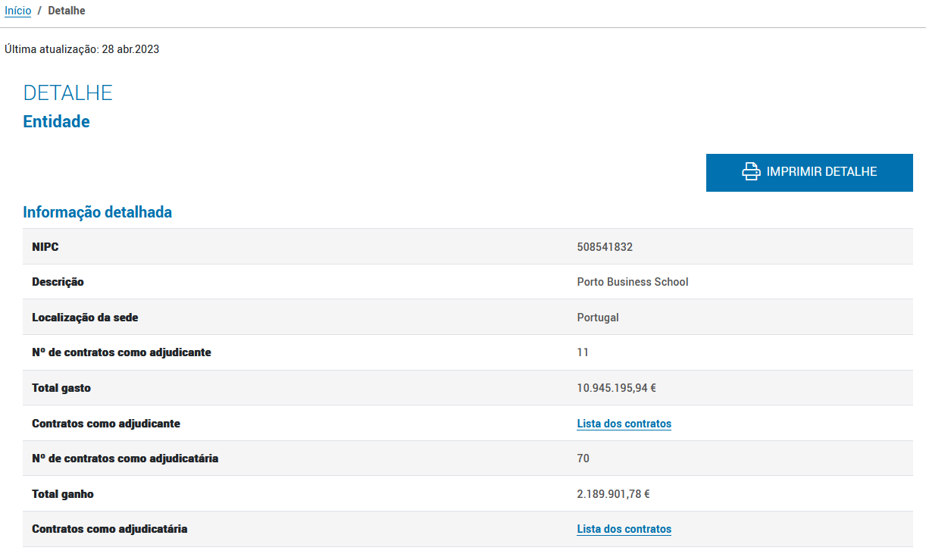

PBS
OSINT
THE POWER OF OSINT
OSINT - Companies
Demo Time
 | Entity (link) Contracts (link)
Page 31

Slide 32
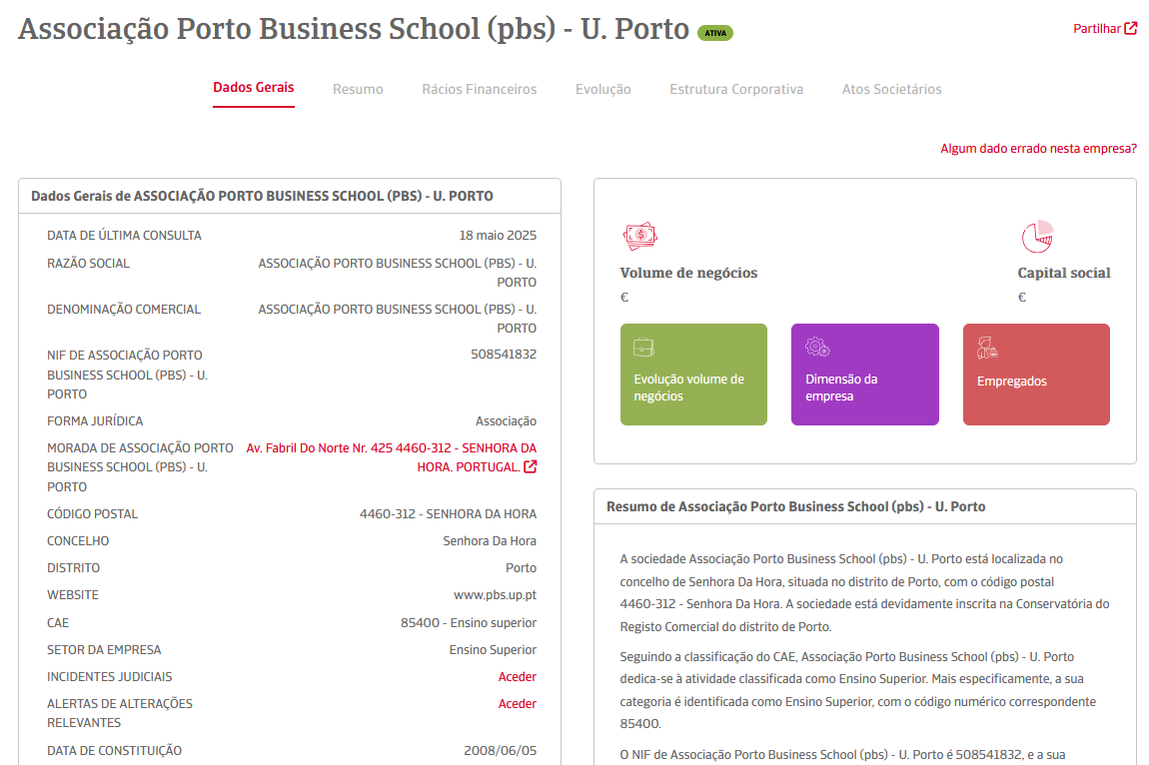
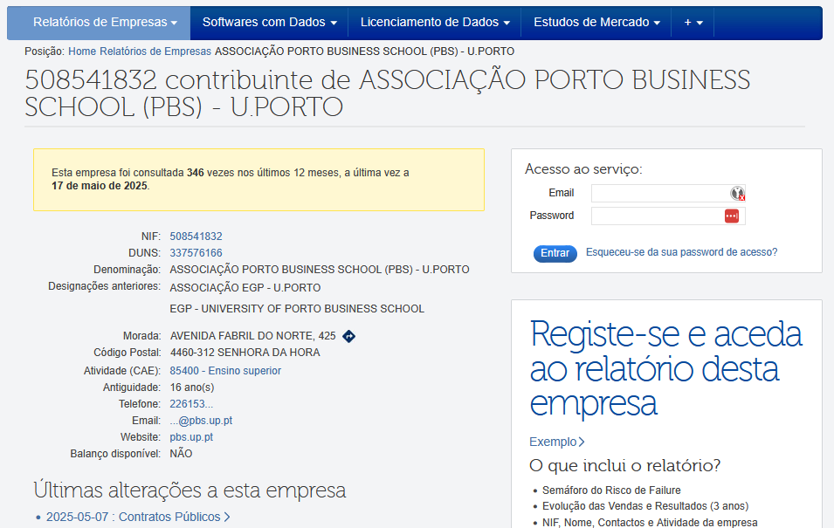
PBS
OSINT
THE POWER OF OSINT
OSINT - Companies
Page 32

Slide 33
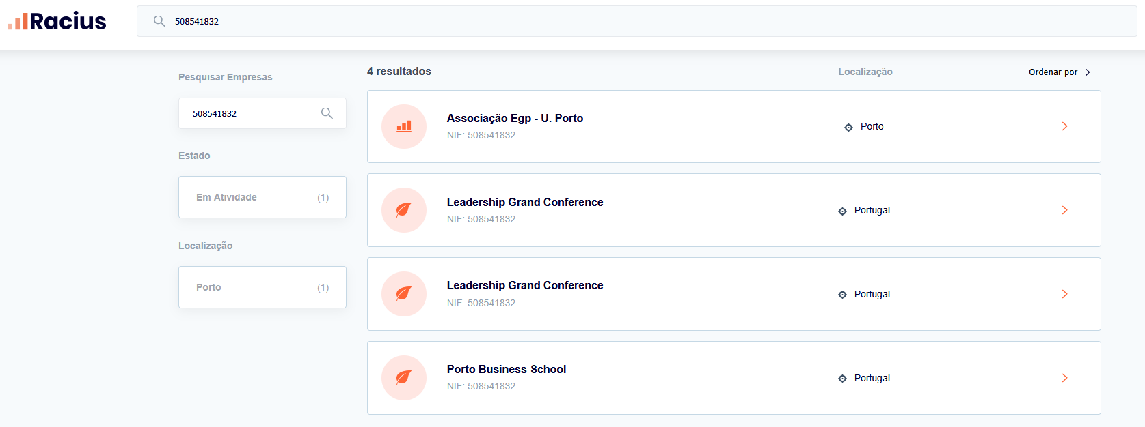
PBS
OSINT
THE POWER OF OSINT
OSINT - Companies
Page 33

Slide 34
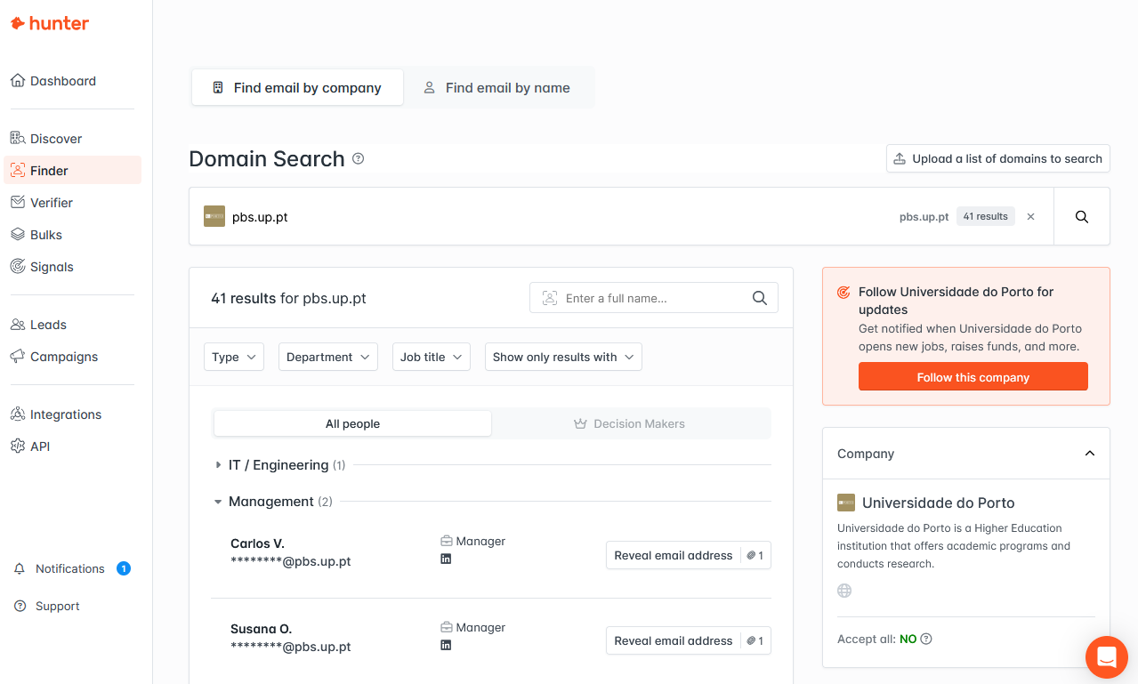
PBS
OSINT
THE POWER OF OSINT
OSINT - Companies
Page 34

Slide 35




PBS
OSINT
THE POWER OF OSINT
OSINT - Vehicles
Portal | Automóvel On-line
 | Certidão Permanente do Registo Automóvel (link) Document example (link) Demo: search for a car (link) License Plate : 89-QS-04 (link)
Portal | IMT - Instituto da Mobilidade e dos Transportes
 | Serviços IMT online.pt (link) Veículos → Certidão Mandatory inspection Vehicle characteristics
Portal | ASF – Autoridade de Supervisão de Seguros e Fundos de Pensões
 | Check Insurance (link) License Plate : 89-QS-04
Portal | Lastvin
 | Mercedes-Benz VIN Decoder (link) Will the prime-minister keep the car?
Hack across the globe by VIN (link)
Page 35

Slide 36


PBS
OSINT
THE POWER OF OSINT
AITI – Brunei Darussalam
Authority for Info-communications Technology Industry of Brunei Darussalam
Page 36

Slide 37

PBS
OSINT
THE POWER OF OSINT
Page 37

Slide 38

PBS
OSINT
THE POWER OF OSINT
Internet Search - Curriculum Vitae
Google Search
"curriculum vitae" filetype:pdf site:.pt (link)
“curriculum vitae” filetype:pdf inurl:upload (link)
Curriculum Vitae
Sending CV with too much information – what is too much
Home address – Street View
Professional information phishing
Fake job adds (Is this a thing?)
Page 38

Slide 39

PBS
OSINT
THE POWER OF OSINT
Internet Search - Pay slip
Don’t open links just because they are available.
It’s like entering a house just because the door was open. Would you do that ?
Google Search (link)
Bing Search (link)
Yahoo Search (link)
“recibo de vencimento” filetype:pdf
“recibo de vencimento” – keywords to look for
filetype:pdf - only pdf files
Available information on pay slips
Full name, address, nif, nib, marital status, number of children, ...
Page 39

Slide 40

PBS
OSINT
THE POWER OF OSINT
Internet Search - Hacked Websites
Google Search (link)
allintitle:“hacked by” site:pt
“hacked by” - keyword to look for
site:pt - only “portuguese” sites (registered portuguese domains)
About 6.200 results
Sites / pages that were “tagged”/”signed”
Attack and contents changed to show off skills (mainly kids)
compared to street tagging
Page 40

Slide 41
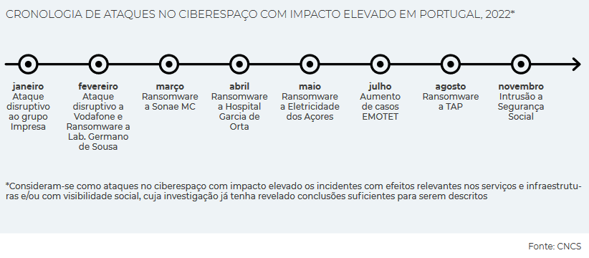
PBS
OSINT
THE POWER OF OSINT
Data breach - When companies are hacked
When companies are hacked, private data is exposed. Private data becomes “public”. (link)
Troy Hunt
HaveIBeenPwned (link)
Pwned websites (link)
Domain search (link)
CNCS Report
Cybersecurity in Portugal 2024 (link)
Cybersecurity in Portugal 2023 (link)
Page 41

Slide 42
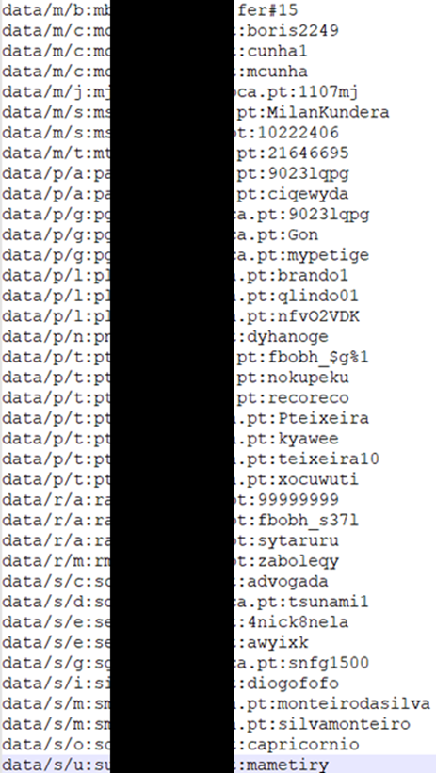
PBS
OSINT
THE POWER OF OSINT
Data breach - Credentials
Source
“Publicly” available list of credentials
Information gathered
Rule of email/login
Rule of password complexity
List of users
Phishing campaigns
Brute force
Look for those users on Social Media
Reuse of credentials
Page 42

Slide 43
PBS
OSINT
THE POWER OF OSINT
Data breach – Credentials - Portuguese domain examples (2018)
uminho.pt - Universidade do Minho
adv.oa.pt - Ordem dos Advogados
pj.pt - Policia Judiciária
mail.exercito.pt - Exército
cm-braga.pt - Câmara Municipal de Braga
cm-guimaraes.pt - Câmara Municipal de Guimarães
psd.pt - Partido Social Democrata
ps.pt - Partido Socialista
fcporto.pt - Futebol Clube do Porto
min.justiça - Ministério da Justiça
Page 43

Slide 44
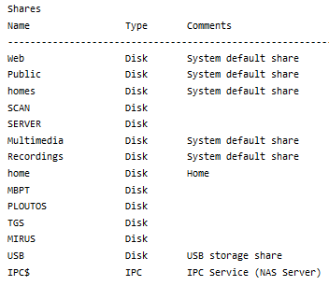
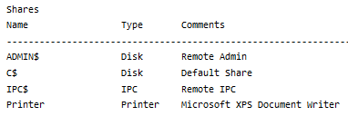
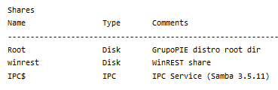
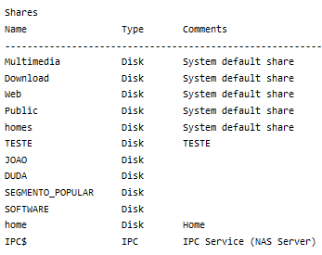
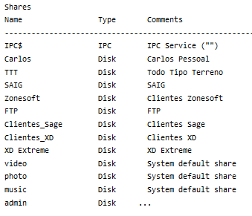
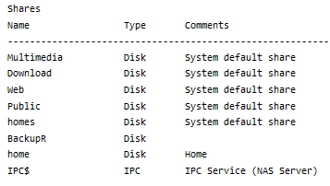
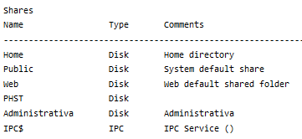
PBS
OSINT
THE POWER OF OSINT
IOT Search engines
Shared folders accessible to 8 thousand million people (link)
Contabilidade – 6
Clientes – 3
Faturacao – 1
Primavera – 6
SAGE – 13
Winrest – 148
Page 44

Slide 45
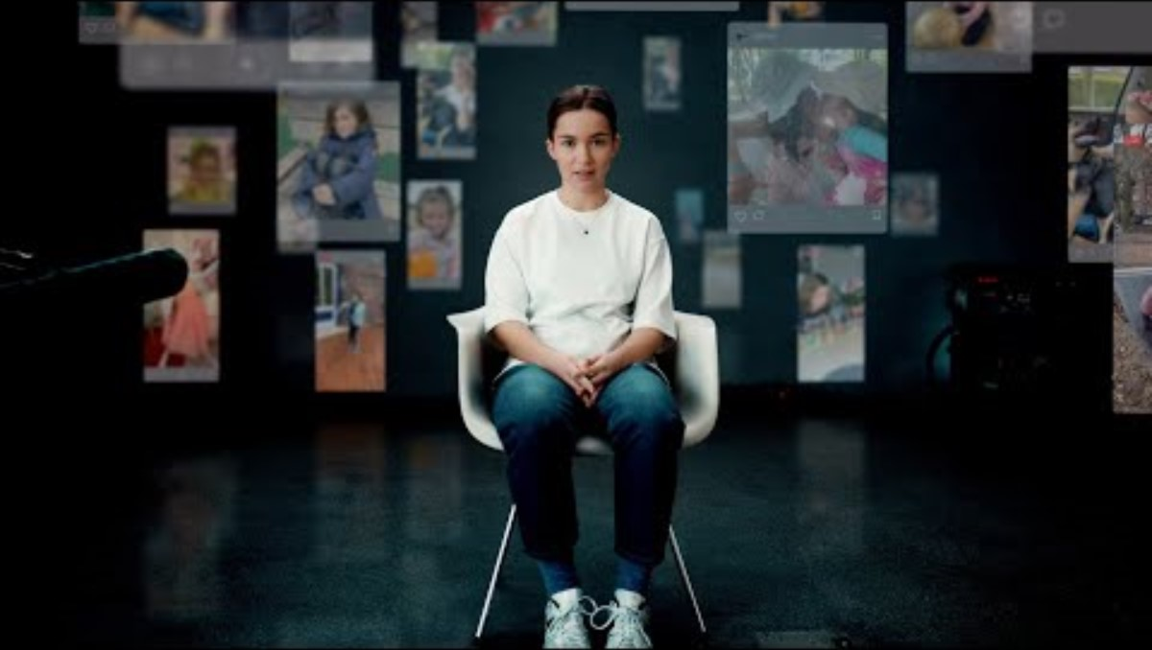

PBS
OSINT
THE POWER OF OSINT
Message from Ella
Page 45
Deutsche Telekom Message from Ella | Without Consent

Slide 46

PBS
OSINT
THE POWER OF OSINT
Internet of Things
Page 46

Slide 47
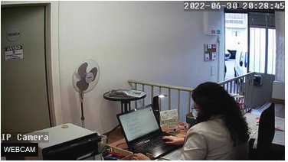
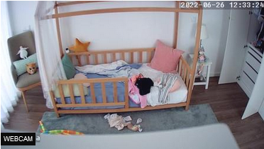
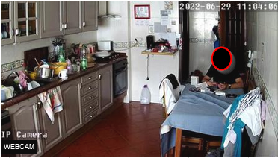
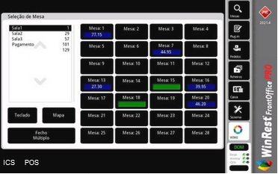
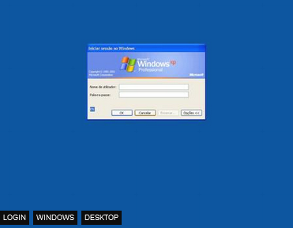
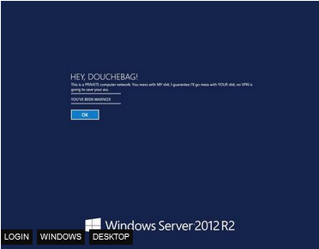
PBS
OSINT
THE POWER OF OSINT
OSINT - Shodan – IoT Search Engine
Page 47

Slide 48
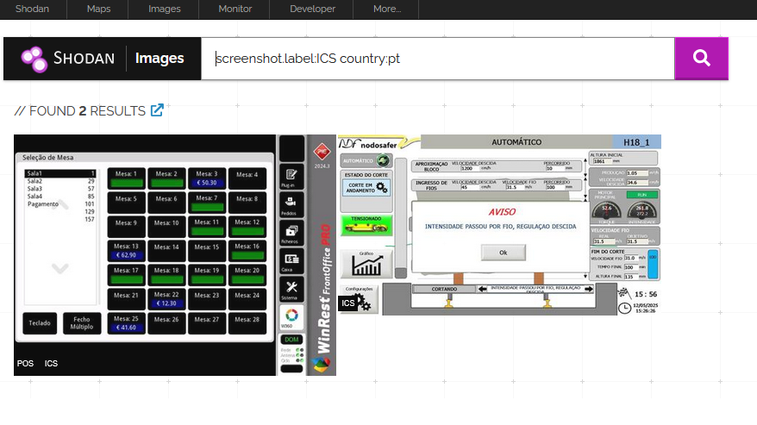
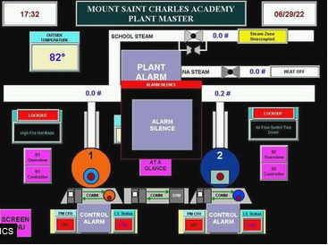
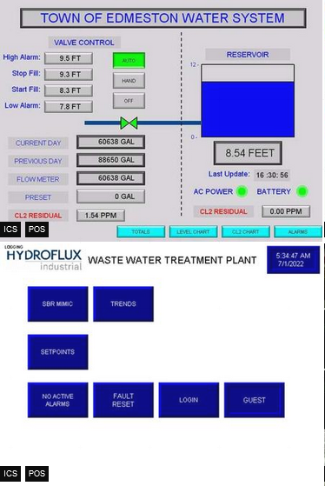
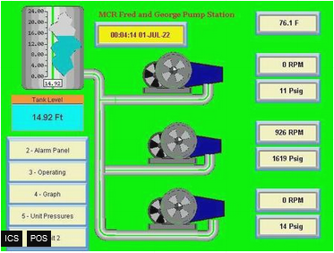
PBS
OSINT
THE POWER OF OSINT
OSINT - Shodan – IoT Search Engine
Page 48

Slide 49
PBS
OSINT
THE POWER OF OSINT
OSINT - Shodan – IoT Search Engine
Internet Exposure Observatory
Exposure Dashboard (link)
Explore
Shodan explore (link)
Images
Shodan images (link)
Maps
Shodan maps (link)
Remote Desktop (link)
Total results: 2,745,593
Braga (link)
Imagens
Braga (link)
VNC Remote Access and Loggedin (link)
Authentication Disabled
Portugal (link)
Fotos (link)
Contabilidade (link)
Page 49

Slide 50
PBS
OSINT
THE POWER OF OSINT
Before OSINT
Don’t get under the spotlight.
Page 50

Slide 51

PBS
OSINT
THE POWER OF OSINT
OSINT – Sock Puppet
Temporary Email (link)
Name Generator (link)
Photo - thispersondoesnotexist (link)
Sim Card - Local / Country / Electronic
Credit Card - Privacy.com (link)
VPN - useful to be some where else
Email account
Social Media accounts
Sock Puppets Tutorials
The Art Of The Sock (link)
My Process for Setting up Anonymous Sock Puppet Accounts (link)
Page 51

Slide 52
PBS
OSINT
THE POWER OF OSINT
OSINT REFERENCES
My OSINT notes (link)
Sofia Santos - Awesome tutorials and exercises (blog) (videos)
Jezer Ferreira - Must have book and conference (book) (conference)
Michael Bazzel - IntelTechniques (link) (book) (magazine)
OSINT Combine (link) (bookmarks)
OSINT Dojo (link)
OSINTCurio.us (link)
OSINT Techniques (link)
CyberDetective (link)
Open Source Intelligence Tools and Resources Handbook 2020 (link)
Page 52

Slide 53
PBS
OSINT
THE POWER OF OSINT
OSINT CHALLENGES
Sofia Santos Exercises (link)
TraceLabs CTF (link) (notes)
Hacktoria (link) (notes)
Kase Scenarios (link)
TryHackMe (link)
My notes (notes)
Geolocating Images Room (link)
Google Dorking (link)
OhSINT Room (link)
Sakura Room (link)
Page 53

Slide 54

PBS
OSINT
THE POWER OF OSINT
OSINT -Tools & more tools
OSINT FRAMEWORK (link)
OSINT4ALL (link)
Intel Techniques (link)
OSINT Techniques (link)
Cyber Detective (link)
Aware Online (link)
Page 54

Slide 55
PBS
OSINT
THE POWER OF OSINT
OSINT – Virtual Machines
Trace Labs VM (link)
Mandiant – Threat Pursuit VM (link)
CSI Linux (link)
Tails (link)
Kali (link)
Parrot (link)
Windows (link)
Page 55

Slide 56
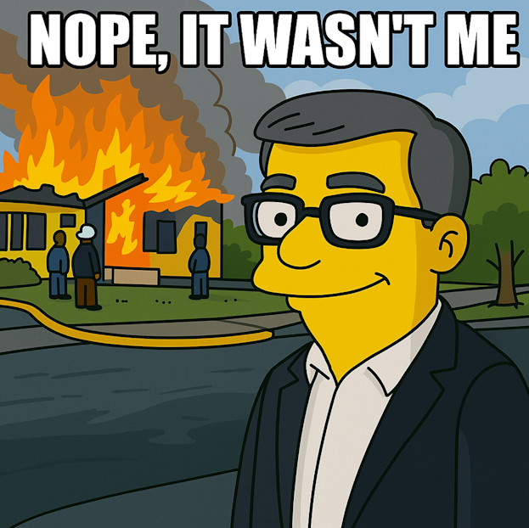
OPOSEC
OSINT
PRIVATE BUSINESS, PUBLIC FALLOUT
PBS
OSINT
THE POWER OF OSINT
THANK YOU
Page 56

Slide 57
PBS
OSINT
THE POWER OF OSINT
OSINT – The Final Hours of Pop Smoke
Rapper Pop Smoke Murdered in Home Invasion ... By 4 Masked Gunmen (link)
Instagram Posts
Location Tag
Geolocation
Reverse Image
Google Maps
Local Recon
Airbnb/Zillow (Rent/Real-estate)
House photos (Outside and Inside)
Layout
Page 57

Slide 58
PBS
OSINT
THE POWER OF OSINT
OSINT – Other public presentations
RootedCON - OSINT – Beware your data is out there – EDIÇÃO PORTUGAL (link)
OID2024 – OSINT – Beware your data is out there (link)
0XOPOSEC – Private Business, Public Fallout (link)
PBS - The Power of OSINT (link)
Page 58

Slide 59



PBS
OSINT
THE POWER OF OSINT
Portal | Portal do Governo
 | Membros do Governo (link) Primeiro-Ministro (link) Redes sociais
Portal | Publicações de Atos Societários
 | Consultar e pesquisar todas as publicações (link)
https://www.doutorfinancas.pt/empresas/como-obter-informacoes-sobre-uma-empresa/ https://transparencia.gov.pt/ Pesquisa de bens penhorados – não oficial (link) Pesquisa de bens penhorados – não oficial (link) https://geneall.net/ https://www.einforma.pt/ https://www.iberinform.pt https://www.racius.com https://www.rigorbiz.pt/ https://www.emailondeck.com/ https://temp-mail.org/ https://www.playmakerstats.com/ https://www.pai.pt/
Portal | Portal da Assembleia da República
 | Deputados em funções (link) Informação Pessoal (link) Registo de interesses (link) Participação em empresas (link) Dados Abertos (link)
Portal
 | Pesquisa (link) Site alternativo – DRE Tretas (link)
Portal | Portal BASE
 | O Portal BASE centraliza a informação sobre os contratos públicos (link) Contratos (link) Anúncios (link) Entidades (link) Empresas e Pessoas Indicadores (link)
Lista de subvenções e benefícios públicos e de doações (IGF) (link) Lista pública de execuções (link) Venda de Bens Penhorados em Processos Executivos (link) Lista de devedores na Segurança Social (link) Listas de Devedores na Autoridade Tributária e Aduaneira (link)
Page 59

